Slide 1
Cloud Native Intro
The Cloud Native Platform
Platform Architecture Team

Slide 2
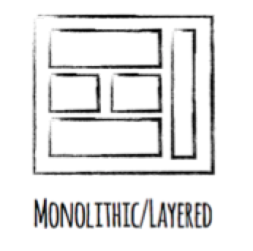
Monolith Applications
Great for the first deployment …
What about the updates ?
Tightly coupled - Holistic approach
Reliability - Adding layers & change processes
Backwards compatibility - Regression testing
Notes:
Monoliths, G8t for 1st deployment but what about day 2 (What do I need to regression testing for if I change one line of code?)
Test, deploy, release and scale as a whole. A lot of regression testing
Layers of processes to protect it.
There are new architectures emerging on top these lightweight app servers to address the scale, speed and safety: new ways of tackling cloud scale and speed to market.
These architectures have emerged from the internet giants as such an alternative: a change in culture, organization structure and technology that allows teams to work more independently, and increase velocity. It’s a key part of cloud-native applications, which we’ll talk about shortly.
Microservices are both a cultural and organizational change as a change in how we design and implement systems.
If running a busy restaurant is like producing software, restaurants can’t deal with the “Friday night rush” simply by calling in more cooks, kitchen staff, and waiters. They only have the existing capacity their kitchen facilities allow them.. adding more people to a small kitchen actually makes it worse: people start tripping over each other due to lack of space, sharing tools, and being forced to coordinate under pressure. Similarly with waitstaff.
If restaurants had a magic button that would allow them to instantly provision a whole new restaurant next door ready to go, with no wait for construction time and building permits, then presto!
Suddenly adding more people equals making food faster, and servicing a rush of customers without blinking.
In a cloud world, each team gets it’s own “restaurant”, which can be de/provisioned instantly as needed.

Slide 3
Monolith Technology Choice & Scaling
A
B
A
B
A
B
C
D
C
D
C
D
A is mission critical used all the time with predictable load
B is mission critical with spikey load
C is mission critical with low usage
D is not mission critical and is occasionally used
Notes:
Let’s say we have 4 different types of applications we need to build and run them on traditional approach & platform. We would be running them on one server so forced to make a technology choice. No one technology is the best for everything, right? One language right, but .NET might be better for GUIs based apps and JAVA might be better for building back end heavy transactional and high performing systems
Suddenly there is a need to increase capacity. How we would do this using traditional approach? How we would scale this system?
But what if different parts of a monolithic application have different scale characteristics? <CLICK X4 to build text> ROS
Some apps need more CPU power and some need more Memory
<CICK 2X to build scale>
But with monoliths, it is all or none, more often then not apps are competing for resources
Scaling out monolithic applications is difficult and can be wasteful in terms of resource usage

Slide 4
Microservices Scaling Out
A
A
A
A
A
A
mission critical 24/7 with predictable load
B
B
B
B
mission critical with spikey load
C
C
mission critical with low usage
D
not mission critical & occasionally used
Notes:
With microservices each microservice is scaled out independently
With auto scaling capabilities in the underlying PaaS that runs the micro services we can achieve very fine grained control over resource usage (CPU usage above/bellow level)
Maybe some features are CPU bound and need low amounts of RAM we can run more instances of these with lower amount of memory
Maybe some features are RAM bound and not as much CPU so we can run less CPU instances with more RAM
The ability to give each microservice the right number of instances, the right amount of RAM, Disk and CPU is one of the major benefits of micro services.

Slide 5
Technology Choices
Then
Now
Java
Go
A
B
Java
A
B
C
D
.NET
Ruby
C
D
Monolithic Application implemented using a single technology
Each microservice can be implemented using the best technology for the feature
Notes:
Each micro service can use the best technology for the problem
Pick the right language, the right type of database for the problem at hand
The MS are small enough that it should be easy to rewrite the micro service from one technology to another (CF component Ruby-Go)
Writing every MS in a different language while possible is a bad idea, the key concept is that we have the freedom to experiment with new technology and don’t get stuck for years with yesterdays technology
Overtime through experimentation the best stacks for a particular company will emerge and will be both a technical & cultural fit into the company

Slide 6

ASP
Monolithic Application
HTML
JavaScript
DLL
ASP
DLL
DLL
DLL (Nuget)
Data Access
Persistent Store
(Database)

Slide 7
ASP.NET
“Modular Monolith”
HTML
JavaScript
DLL
ASP.NET
Business DLL
Nuget
DLL
Data DLL
Persistent Store
(Database)

Slide 8
Microservices
… no more dependencies! Yeah!
HTML
JavaScript
HTTPS
HTTPS
App 3
App 1
App 2
1
2
1
2
3
4
1
2
3
4
DLL
DLL
DLL
CIRCUIT BREAKER
HTTPS
App 4
1
2
3
CACHE
DLL
Persistent Store
(Database)
Persistent Store
(Database)

Slide 9
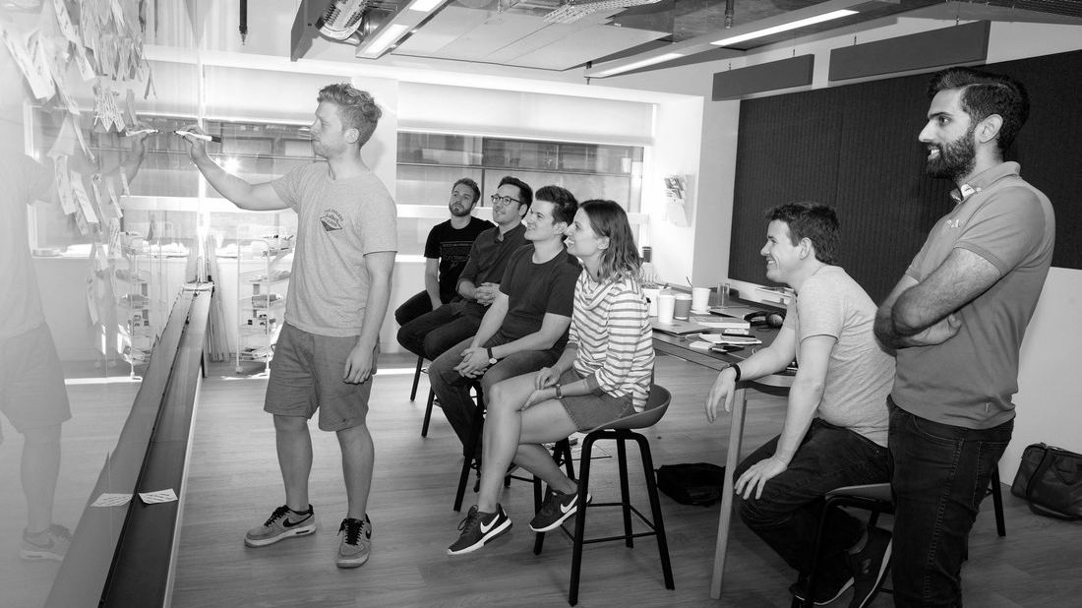
Going Cloud Native

Slide 10
What is “cloud native”?
An approach to building and operating software that takes advantage of the cloud-computing model. Often seen as a combination of microservices, continuous delivery, containers, and DevOps.

Slide 11
The Starting Point
Cloud Native
Microservice Architecture
API first design
Design for failure
Proactive testing for failure
Apps are unaffected by dependent service failure
Integrated Metrics and Monitoring
Cloud agnostic runtime implementation
Cloud Resilient
Cloud Friendly
12 Factor apps
Horizontally scalable
Leverage platform for HA
Cloud Ready
No file system requirements
Containerized
Platform managed addresses and ports
Consume Platform services

Slide 12
Cloud Native Design - 12 factors
Codebase
One codebase tracked in revision control, many deploys
Dependencies
Explicitly declare and isolate dependencies
Configuration
Store config in the environment
Backing services
Treat backing services as attached resources
Build, release, run
Strictly separate build and run stages
Processes
Execute the app as one or more stateless processes
Port Binding
Export services via ports
Concurrency
Scale out via the process model
Disposability
Maximize robustness with fast startup and graceful shutdown
Dev/Prod Parity
Keep dev to prod as close as possible
Logs
Treat logs as event streams
Admin Processes
Run admin and management tasks as one-off processes

Slide 13
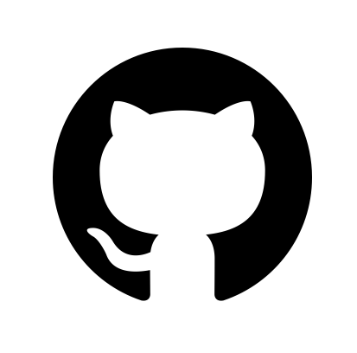
Cloud Native Design - Codebase
ExpenseIT
v 1.0.0
ExpenseIT
v 1.1.0
Expense
Tracking
Codebase
One codebase tracked in revision control, many deploys
ExpenseIT
v 1.1.1
ExpenseIT
v 2.0.0

Slide 14
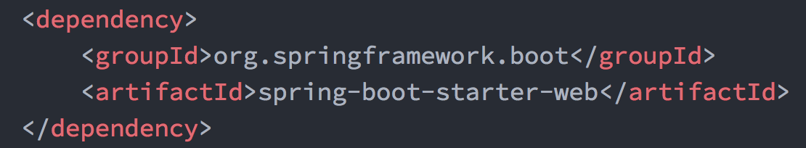
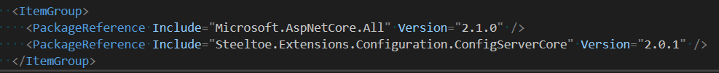
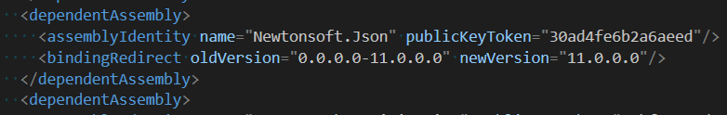
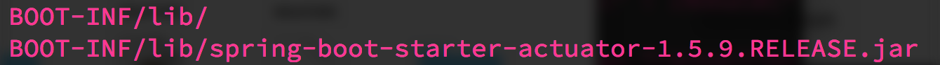
Cloud Native Design - Dependencies
Declaration
Explicitly declare and isolate dependencies
Isolation

Slide 15
Cloud Native Design -
Configuration
ExpenseIT
v 1.1.0
ExpenseIT
v 1.0.0
ExpenseIT
v 2.0.0
Store configuration external to application
Config Server

Slide 16
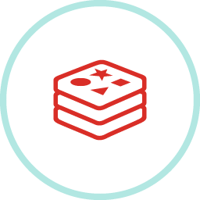



Cloud Native Design -
Backing Services
ExpenseIT
v 2.0.0
Treat backing services as attached resources
Attached Resources

Slide 17
Cloud Native Design -
Build, Release, Run
Build
Strictly separate build, release and run phases
run
Build
Release
v 1.1.1
Config
{ }

Slide 18
Cloud Native Design -
Processes
Build
Stateless Processes
Execute the app as one or more stateless processes
Stateful Backing Services

Slide 19

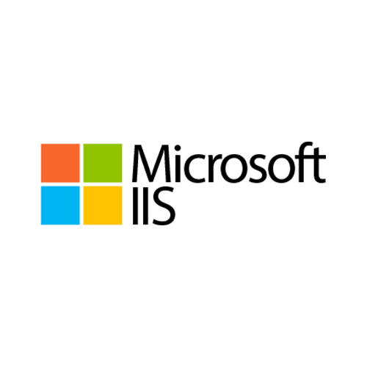


Cloud Native Design -
Port binding
7001
8001
9001
Monolith
Monolith
Monolith
Export Services via Port binding
Self contained
Inside out export services
Apps can become backing services for other apps via Port binding

Slide 20

Cloud Native Design -
Concurrency
Scale out via the process model
Build
VMs can only grow so large
Scale apps across multiple processes

Slide 21
Cloud Native Design -
Disposability
prod.cfapps.io
Build
Apps can start or stop at a moment's notice
Maximum robustness with fast startup and graceful shutdown
prod.cfapps.io
prod-tmp.cfapps.io
Strive for fast startup
Build
prod.cfapps.io
And graceful shutdown
Build

Slide 22
Cloud Native Design - Dev/Prod Parity
Time
Personnel
Technology
Developer changes takes day, weeks or months to get into production.
Developers develop code and Ops deploys code in Silos.
Developers use one technology in lower environments and company uses another in prod (i.e windows to linux)
Keep dev, staging and production as similar as possible
 | Traditional App | 12-factor App
Time between deploys | days/weeks | mins/hours
Dev vs. Ops | different folks | same folks
Dev & Prod Environments | Divergent | Similar

Slide 23
Cloud Native Design -
Logs
Treat logs as event stream
Apps shouldn’t manage logs
No routing or storage for logs
Unbuffered event stream to stdout

Slide 24
Cloud Native Design -
Admin Processes
Build
Admin Tasks
DB Migrations
Running a console
Clean-up scripts
Versioned with App
Boot Actuators
Boot DevTools
Run admin/management tasks as one-off processes

Slide 25
Writing Twelve Factor ASP.NET Applications
Avoid in-process session state*
For ASP.NET override MachineKey in web.config and on ASP.NET Core avoid persisting keyring to filesystem*
On ASP.NET avoid environment specific configuration in web.config
Avoid Integrated Windows Authentication
Avoid the GAC
Avoid custom IIS handlers
Avoid anything that uses the Windows registry
Avoid using local disk especially for storing application state*
Avoid using any Windows specific or disk based logging*
Avoid any libraries that can’t be bin deployable*

Slide 26

Transforming How The World Builds Software
© Copyright 2017 Pivotal Software, Inc. All rights Reserved.

